Slide 1

Better, Faster, Cheaper, Safer
Why machines MUST replace human labor

Slide 2
In the Fourth Industrial Revolution, marked by the integration of advanced AI systems with cognitive capabilities into business operations, adherence to the four core Key Performance Indicators—Better, Faster, Cheaper, Safer—serves as a set of heuristic principles. Continual focus on these metrics not only maximizes immediate utility but also yields compounding returns that profoundly impact the bottom line over time.

Slide 3

Replace the Oxen
Just as machines replaced oxen in the Second Industrial Revolution for key tasks, advanced AI aims to outperform human labor across specific metrics in the Fourth Industrial Revolution.
Efficiency: Machines took over from oxen because they could perform tasks like plowing and transportation more efficiently, without the need for rest.
Speed: Mechanical systems were faster than oxen, significantly reducing the time required to complete tasks.
Cost: Although initially expensive, machines quickly proved to be cheaper to maintain and operate than keeping and caring for animals.
Safety: Machines offered more predictable and controlled operations, reducing the risks associated with animal behavior.
Scalability: The mechanical advancements allowed for a level of scalability that animal labor simply couldn't match, setting the stage for industrial-scale operations.

Slide 4

Better Than Us
The development of OpenAI's Whisper demonstrates how advanced AI can surpass human capabilities in tasks such as speech-to-text conversion, setting the foundation for universal translation systems that operate at an unprecedented scale and accuracy.
Accuracy: Whisper exceeds human performance in transcribing speech, making fewer errors and demonstrating greater fidelity to the source material.
Speed: With the ability to process audio data at a high rate, Whisper outpaces human transcription services in both speed and turnaround time.
Scale: Whisper can handle multiple languages and dialects simultaneously, offering a level of scale that human translators cannot match.
Availability: Being software-based, Whisper is available around the clock, unlike human services that are constrained by time zones and work hours.
Cost-effectiveness: After initial setup costs, the operational expenses for Whisper are minimal, making it a more cost-effective solution compared to human transcription services.

Slide 5

Faster Than Us
Claude, developed by Anthropic, exemplifies the next frontier of rapid data processing and content creation, enabling tasks such as reading 80,000 words in less than 30 seconds and generating comprehensive articles with minimal input.
Reading Speed: Claude can consume vast volumes of textual information in seconds, far surpassing the speed of even the fastest human readers.
Synthesis: Beyond mere speed, Claude has the ability to quickly synthesize material from diverse domains like science and fiction, turning data into actionable insights.
Content Generation: With Claude, entire Medium articles can be crafted in just one or two passes, a feat unattainable for human writers working at traditional speeds.
Consistency: Claude can maintain its rapid pace of content creation 24/7, free from the physical and mental fatigue that limits human productivity.
Business Impact: By leveraging Claude, a single individual can dramatically accelerate the production of articles, videos, and slide decks, significantly boosting content output and business reach.

Slide 6

Cheaper Than Us
The use of ChatGPT with a Code Interpreter for biostatistics serves as a concrete example of AI's financial advantages. With a subscription cost of just $20 per month, businesses can realize a 400x cost reduction compared to employing a full-time biostatistician.
Direct Cost Savings: Replacing a biostatistician's salary and benefits with a $20/month subscription leads to immediate and significant financial savings.
Operational Efficiency: The AI solution not only costs less but can also operate continuously, maximizing productivity and reducing cycle times.
Scalability: At such low costs, businesses can easily scale their operations by adding more AI capabilities without significantly affecting their budget.
Resource Allocation: The cost savings allow companies to reallocate financial resources to other high-impact areas, fostering innovation and growth.
Competitive Edge: The drastic cost reduction provides a substantial advantage over competitors who continue to rely on more expensive human labor.

Slide 7
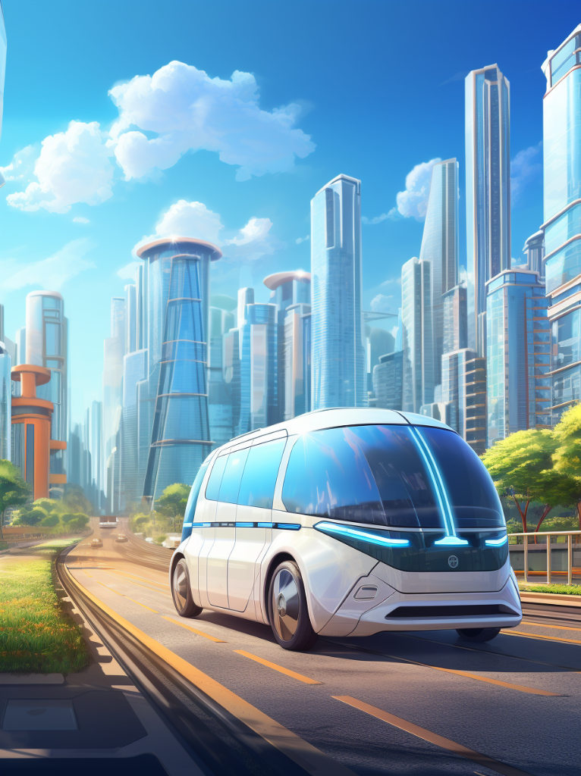
Safer Than Us
With a lower accident rate compared to human-driven vehicles, self-driving cars like Waymo are showing promise in enhancing road safety. Data as of March 2023 indicates a rate of 0.59 accidents per million miles for Waymo, compared to the general U.S. rate of 2.98.
Reduced Accident Rates: Self-driving cars currently have a significantly lower accident rate per million miles compared to human drivers, indicating greater overall safety.
Lives Saved: It's estimated that autonomous vehicles could save approximately 21,700 lives per year by 2050 and prevent up to 4.22 million accidents.
Ongoing Improvements: Although there have been 18 definite fatalities involving Level 2 ADAS cars between 2019 and 2023, the technology is still evolving, suggesting that safety will likely improve over time.
Predictability: The algorithms governing self-driving cars are designed for safe operation, reducing the impact of human errors such as distraction, fatigue, and emotional decision-making.
Risk Mitigation: As autonomous technology continues to evolve, methods for identifying and mitigating risks are also improving, aiming for an even safer transportation environment in the future.

Slide 8

“Human In The Loop” Myopia
The mantra of keeping a ‘human in the loop’ often serves as a palliative measure aimed at reducing fears about job dislocation due to AI. However, this approach is not only ineffective but also potentially unethical and counterproductive when machines outperform humans across key performance metrics.
Ethical Dilemma: Once machines surpass human capabilities in being better, faster, cheaper, and safer, maintaining human involvement becomes an ethical issue, putting businesses at risk of compromising on these key metrics.
Inefficiency: Keeping a human in the loop introduces unnecessary bottlenecks, slowing down processes that could otherwise be more streamlined.
Cost: Human labor is often more expensive and less reliable than machine operation, making the 'human in the loop' model less financially viable in the long run.
Safety Concerns: The introduction of human factors such as fatigue and emotional judgment can compromise the safety measures that a fully automated system could maintain.
Competitive Disadvantage: Persisting with a ‘human in the loop’ model could leave businesses trailing competitors who have fully embraced advanced, more efficient AI systems.

Slide 9
Better, Faster, Cheaper, Safer

